Slide 1
2026 CAV RP Symposium
Confirmations
Presented to:
Presented by:
September 1, 2026
CAV RP Symposium
Dvan Cornell & Brandon Wetzel
Commercial Asset Visibility (CAV) team — N85B

Slide 2


Agenda
  WARNING ORDER (WARNORD)
  OPERATION ORDER (OPORD)
  Accountable Property System of Record (APSR) Data retrieval
  APSR & Commercial Asset Visibility Repairables portal (CAV-RP) Data comparison
  Data submission
  Discrepancy resolution
  Key Supporting Documentation (KSD)
  Lessons Learned

Slide 3
  WARNING ORDER (WARNORD)

Slide 4
What is a WARNING ORDER?
Warning Order (WARNORD) — serves as advance notification that NAVSUP will be initiating an upcoming Inventory Confirmation. This email informs you of NAVSUP's upcoming quarterly inventory confirmation supporting the Department of the Navy's Working Capital Fund (WCF) audit campaign. Your organization has been identified as maintaining custody of, or being contractually responsible for, Navy Working Capital Fund – Supply Management (NWCF-SM) materiel.
This Warning Order (WARNORD) will be issued via email two weeks prior to the official Operation Order (OPORD).
Email subject: WARNING ORDER (WARNORD) - Navy Working Capital Fund Confirmation Process
Insert photo or graphic here

Slide 5
  OPERATION ORDER (OPORD)

Slide 6
What is an OPERATION ORDER?
OPERATION ORDER (OPORD) — formally requests your assistance with NAVSUP’s quarterly inventory confirmation supporting the Department of the Navy’s Working Capital Fund (WCF) financial statements. Your organization has been identified as maintaining custody of, or being contractually responsible for, Navy Working Capital Fund – Supply Management (NWCF-SM) materiel.
This OPERATION ORDER (OPORD) will be issued via email two weeks prior to the specific date scheduled for the mandatory retrieval of the NWCF-SM on-hand materiel extract.
Email subject: OPERATION ORDER (OPORD) Navy Working Capital Fund Confirmation Process
Insert photo or graphic here

Slide 7
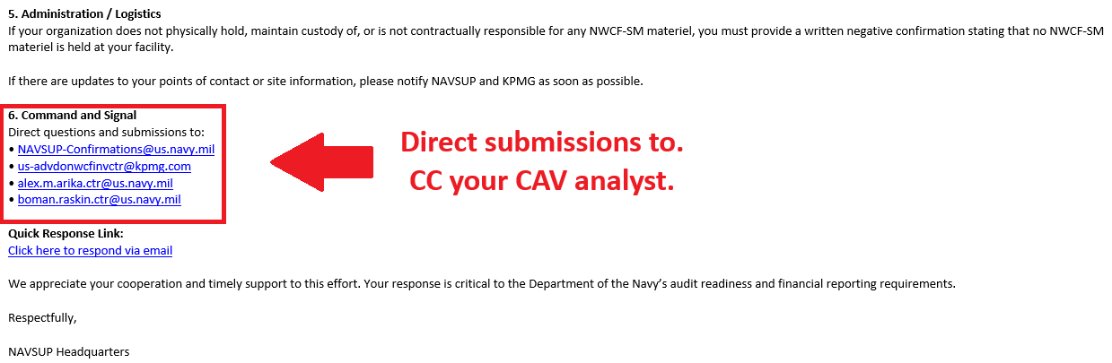
OPERATION ORDER (OPORD) Email – Cont.
Insert photo or graphic here

Slide 8
  Accountable Property System of Record (APSR) Data retrieval

Slide 9

When to pull the Data?
END OF DAY
Extract local APSR data COB on the target date specified in the OPORD email.
Best Practices:
Extract your local and CAV-RP data a few days before the official pull date to begin resolving discrepancies.
If you submit your data after the pull date, run a CAV-RP history report backdated to that specific pull date. Check for any transactions that occurred after the deadline and ensure they are excluded from your submission.

Slide 10
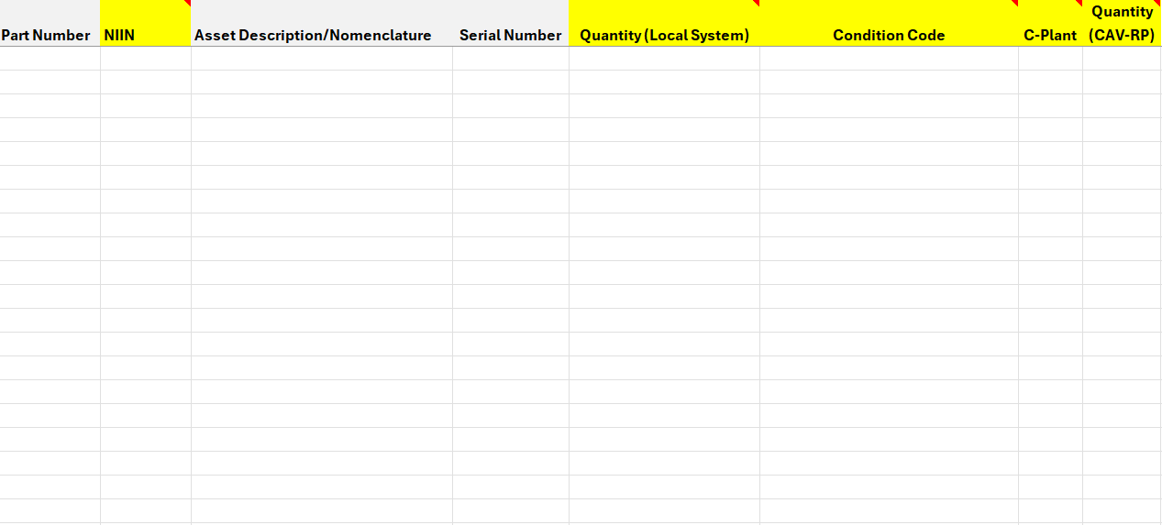
Confirmations Template
Need to Know!
NIIN
Quantity (Loacl System)
Condition Code (e.g., F,M,G,A)
C-Plant (e.g., Cabc)
Quantity (CAV-RP)
Insert photo or graphic here
*Template will be attached to the OPORD email*

Slide 11
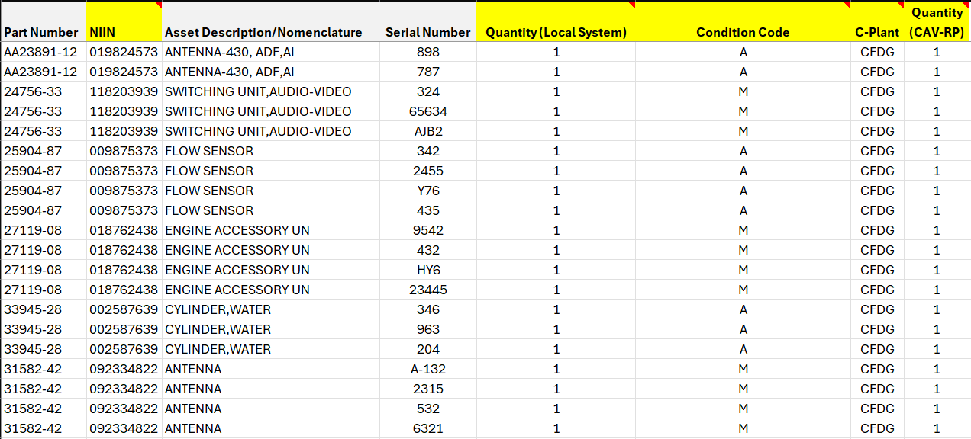
Example #1: Perfect Data Retrieval
Insert photo or graphic here

Slide 12
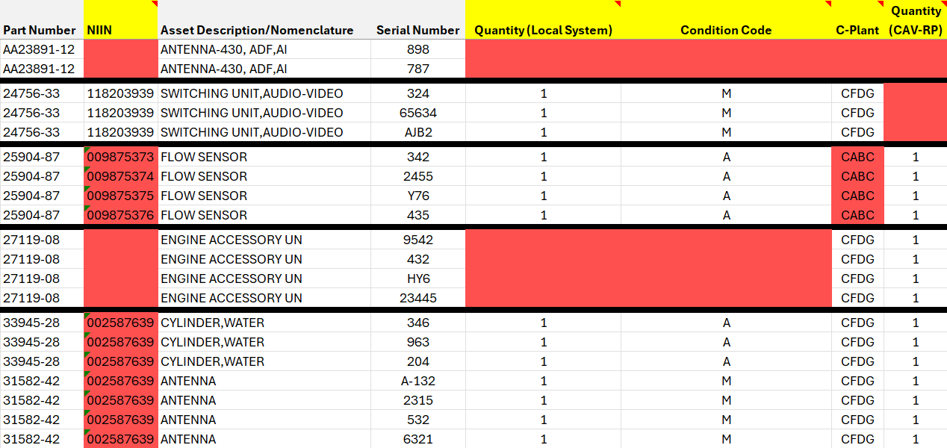
Example #2: Bad Data Retrieval
1
2
3
4
5
Insert photo or graphic here

Slide 13
  APSR & Commercial Asset Visibility Repairables portal (CAV-RP) Data comparison

Slide 14

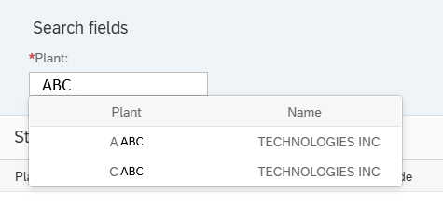
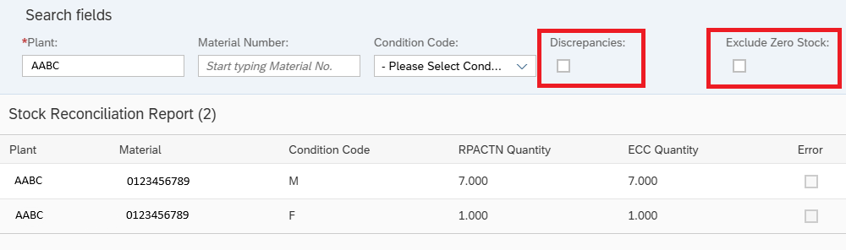
CAV-RP Stock Reconciliation Report – C PLANT
Navy Working Capital Fund material is only held in the C-Plant in CAV-RP!
Utilize the Stock Reconciliation tile
Type your three-digit RIC into the plant field
Take note of the plants that populate for your RIC (e.g., A,C,M)
Uncheck Discrepancies & Exclude Zero Stock

Slide 15
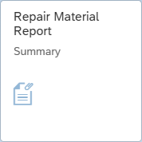
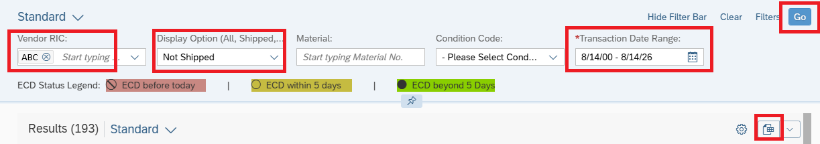
CAV-RP Summary Report
CAV-RP Summary will capture all assets on-hand for your RIC!
Utilize the Repair Material Report Summary tile
Type your three-digit RIC into the Vendor RIC field
Take note that a plant prefix is exclude from this field (e.g., A,C,M)
Change Display Option to Not Shipped & be sure to backdate
We recommend exporting the summary to Excel for a more user-friendly experience

Slide 16
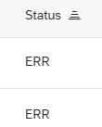
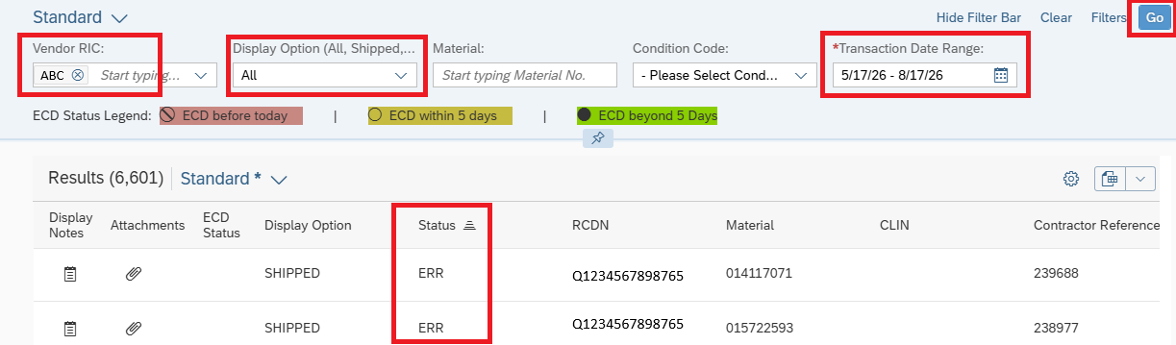
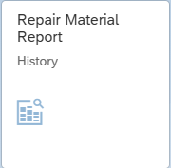
CAV-RP History Report
CAV-RP History will capture all transactional history for your RIC!
Utilize the Repair Material Report History tile
Type your three-digit RIC into the Vendor RIC field
Change Display Option to All
Identify all transactions in ‘ERR’ status and reach out to your CAV analyst for assistance
Submitting late? Filter the history report from the pull date to your submittal date to see all transactions.

Slide 17

Comparison Tips & Tricks
Highlight Duplicates: Use Excel Functions to automatically scan your spreadsheet for duplicate entries.
Compare Condition Codes: Match local APSR condition codes against CAV RP data, where applicable.
Build a Crosswalk Guide: If you do not actively track condition codes, create a reference guide mapping your system statuses to CAV RP condition codes.
Map “Repaired” Status: Map local APSR “Repaired” status (repairs complete, awaiting DCMA inspection) to Report M in your CAV RP submission.

Slide 18
  Data submission

Slide 19

Data submission
When, How, Who!?
When to submit: Follow the deadlines in the OPERATION ORDER email
How to submit: Reply directly to the original OPERATION ORDER email.
Who to copy: Send your completed file to both NAVSUP and KPMG at the following addresses:
NAVSUP-Confirmations@us.navy.mil
us-advdonwcfinvctr@kpmg.com
alex.m.arika.ctr@us.navy.mil
boman.raskin.ctr@us.navy.mil
*Be sure to CC your CAV analyst*

Slide 20
  Discrepancy resolution

Slide 21
How to resolve any Discrepancies
Once our data is submitted, how will we be notified of any discrepancies!
Facilitated by NAVSUP WSS CAV analysts.
Once discrepancies are assigned, your assigned CAV analyst will immediately begin research via the Advana system to reconcile errors between LOCAL APSR, CAV-RP, and ERP.
Responsibilities are divided as follows:
CAV-RP vs. ERP: Handled entirely by the CAV team.
LOCAL APSR vs. CAV-RP: Handled together by your site and the CAV analyst.
Our team will email or call you with a breakdown of the root causes. After aligning on a solution, we will initiate clean-up efforts and coordinate with you to update your LOCAL APSR or CAV-RP.

Slide 22
  Key Supporting Documentation (KSD)

Slide 23
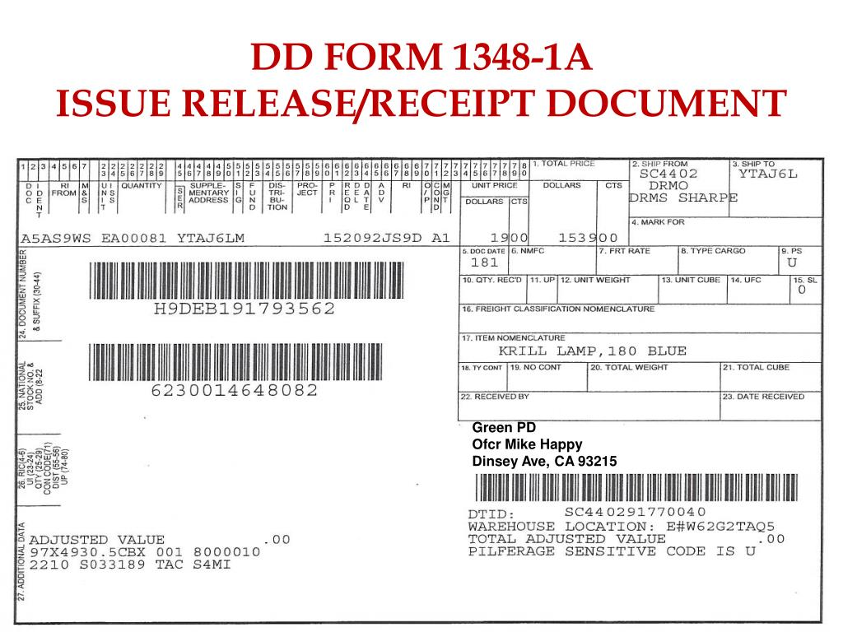
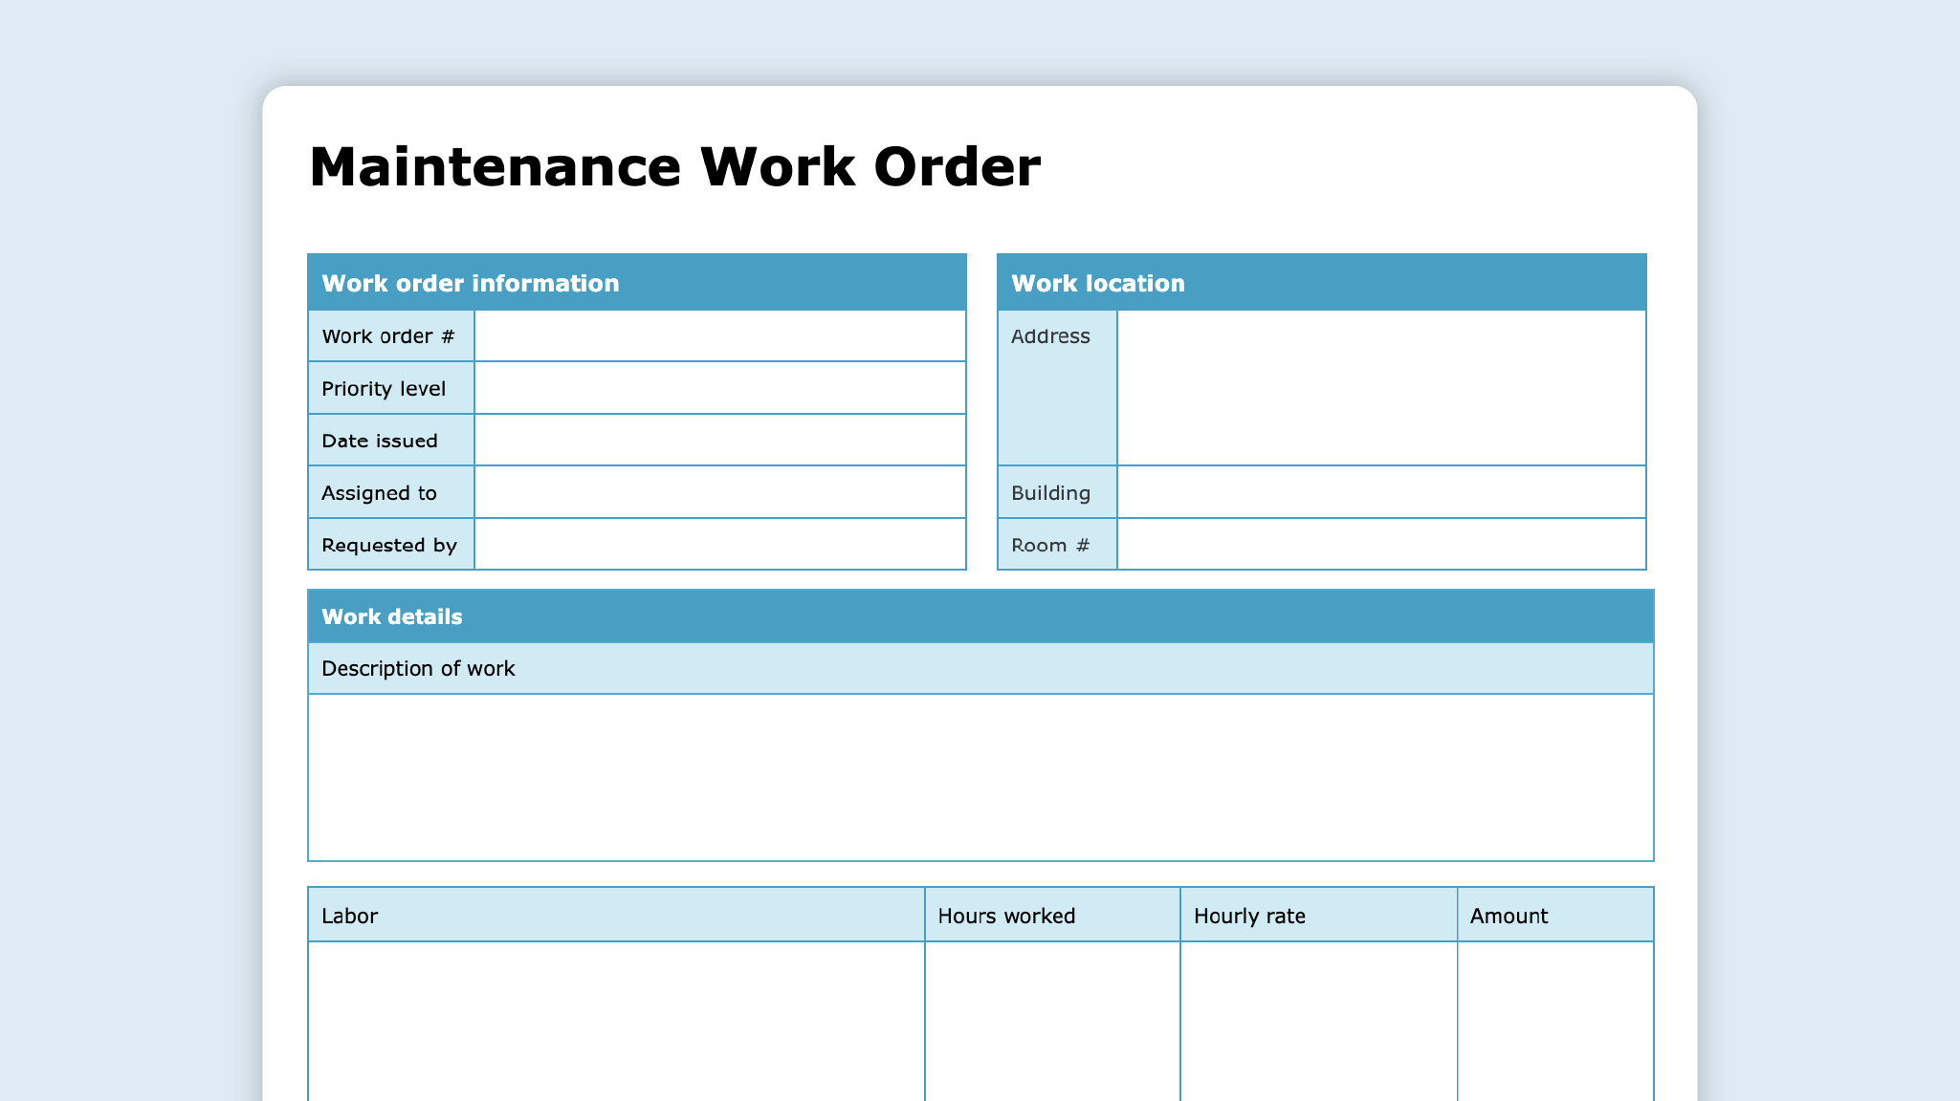

Example KSDs
If you are tracking a discrepancy, please compile the relevant Key Supporting Documents (KSDs) for your scenario.
F Condition- Inbound DD1348 – QTY circled, signed, and dated
M Condition- Internal work order – NIIN/part number, serial number, RMA number
A Condition- DCMA source inspection/WAWF Form DD250 – Outbound DD1348

